Slide 1
Tips and Tricks

Slide 2
What are some tips to make your apps more user friendly?

Slide 3
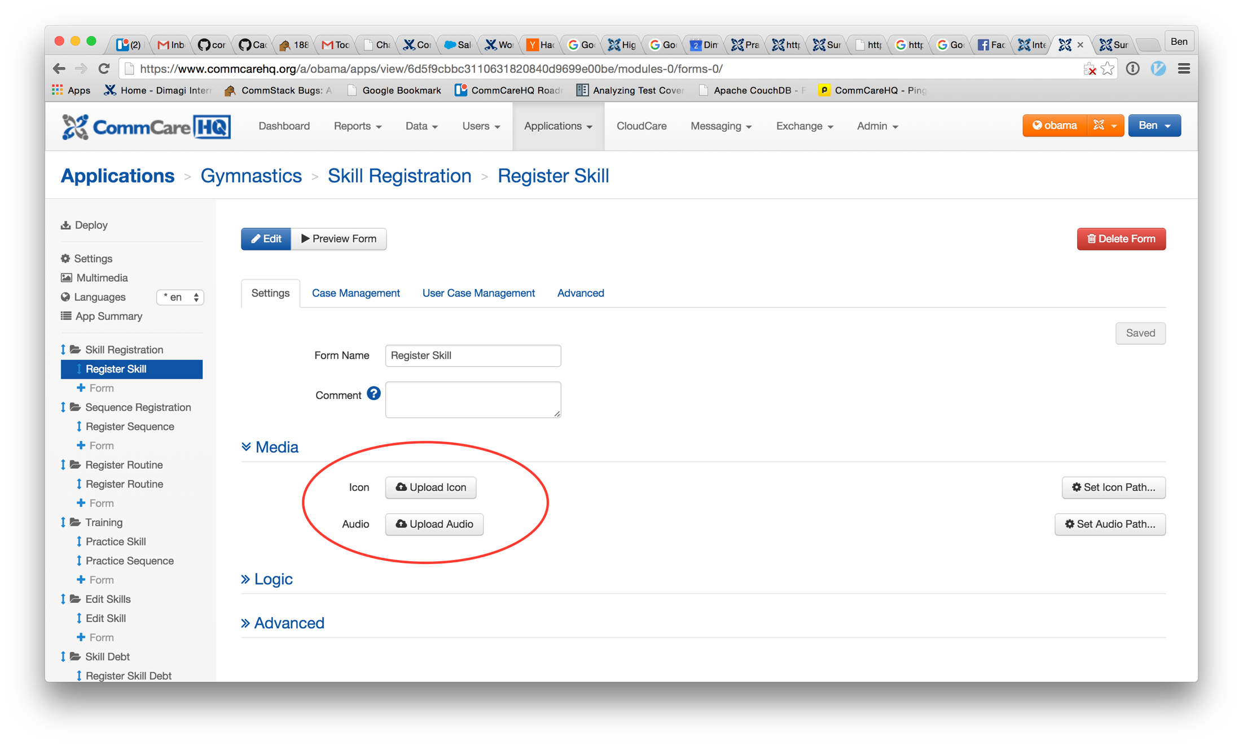
Form Logos
People love logos!!

Slide 4
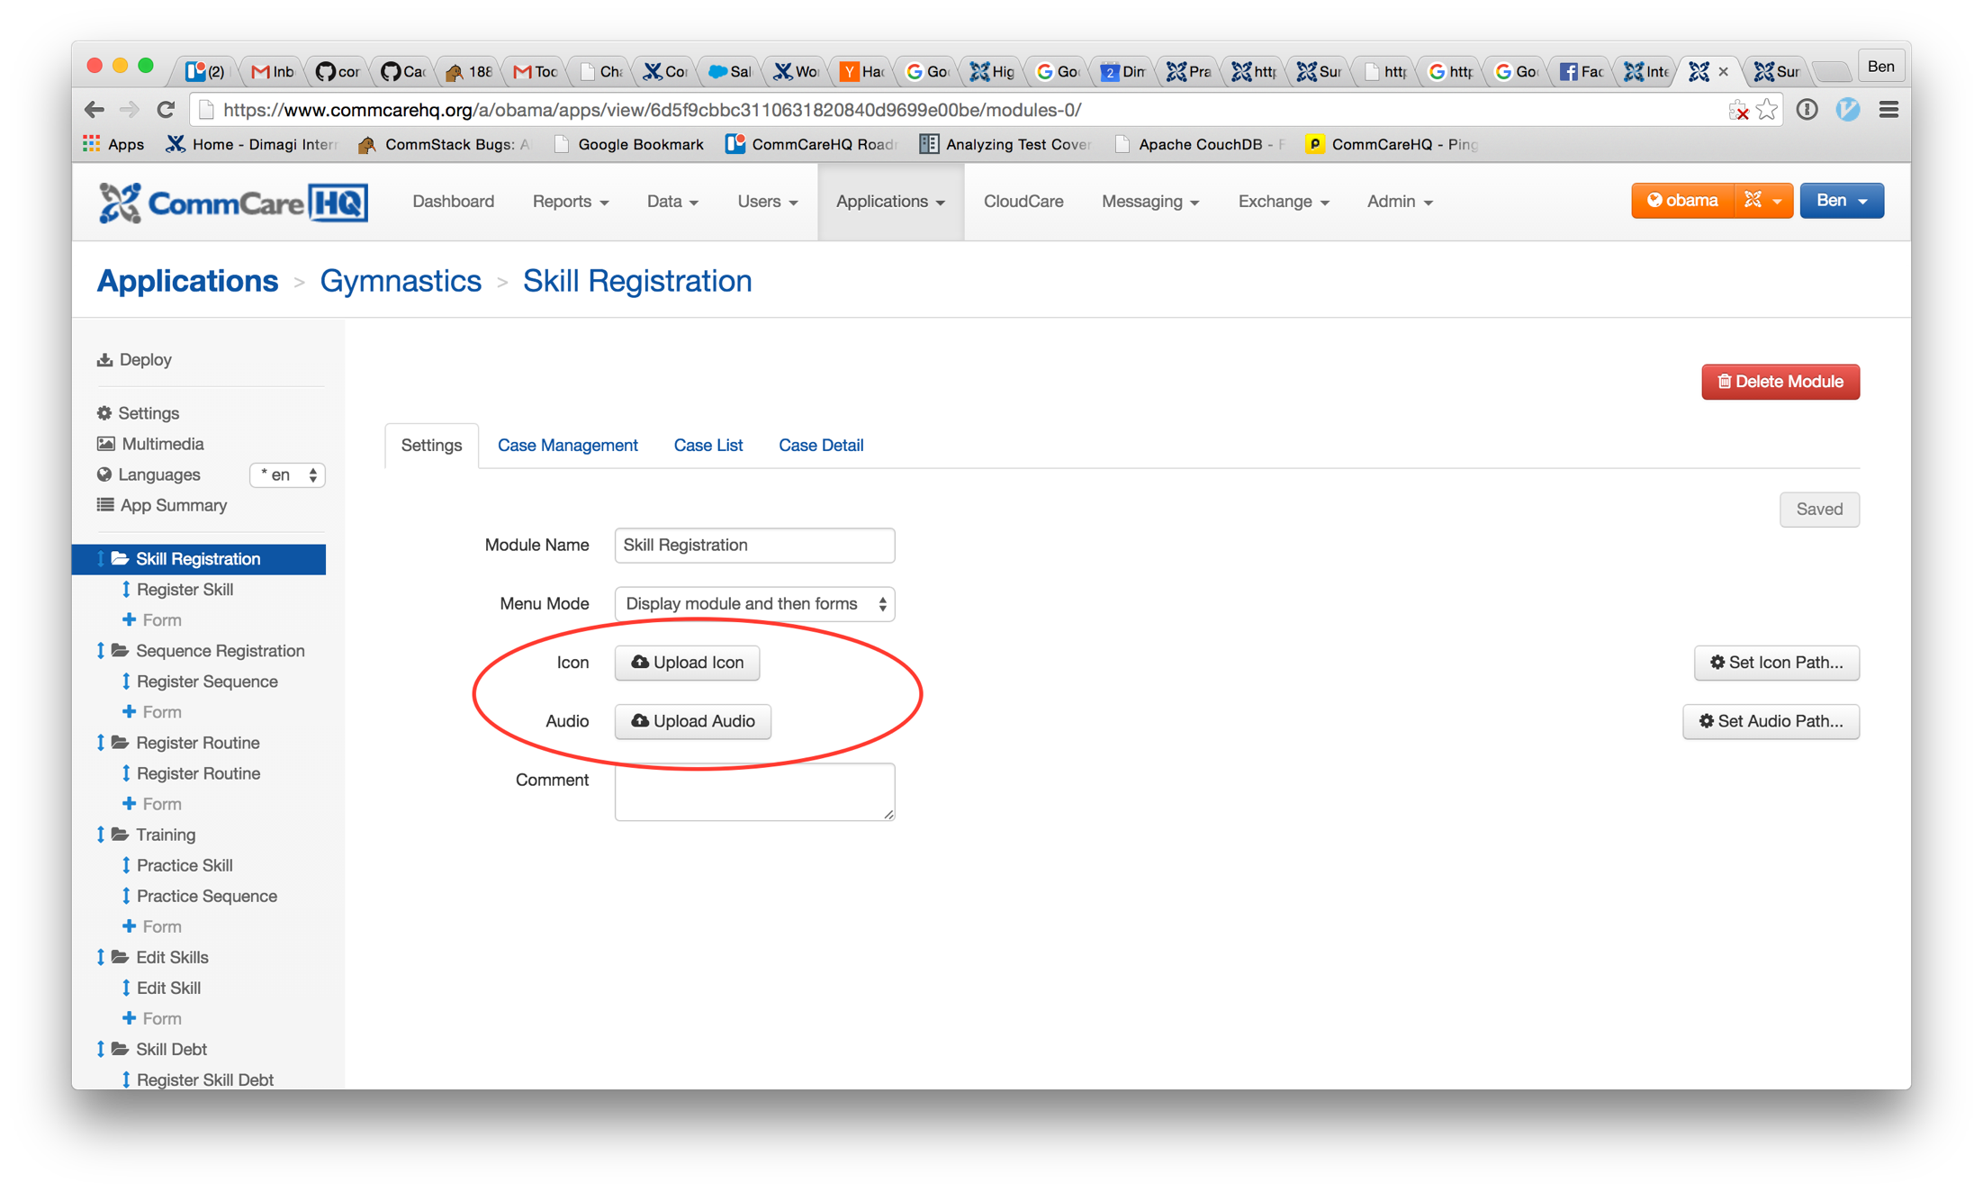
Module Logos
People love logos!!

Slide 5
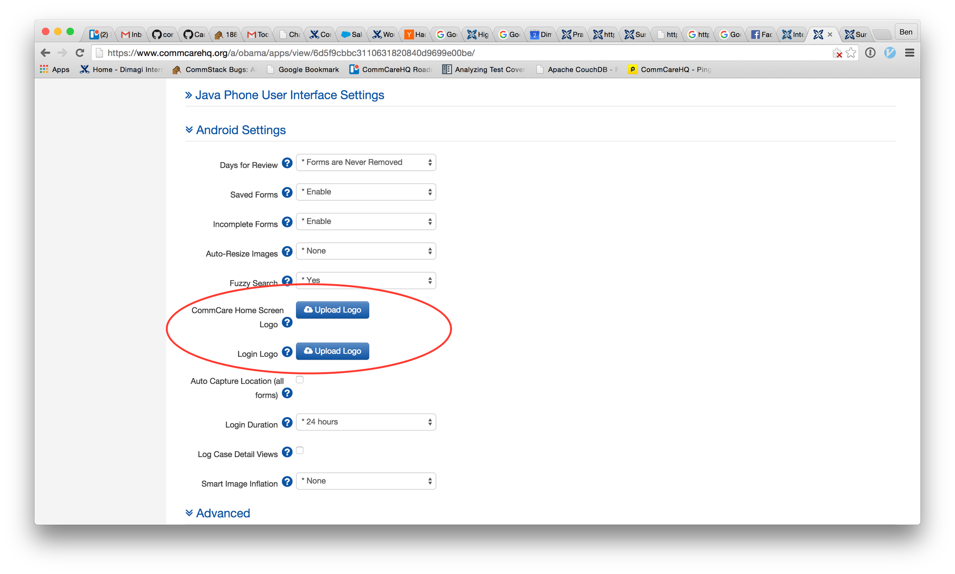
HomeScreen Logos
People love logos!!

Slide 6
Better Navigation!
People like easy to use apps

Slide 7
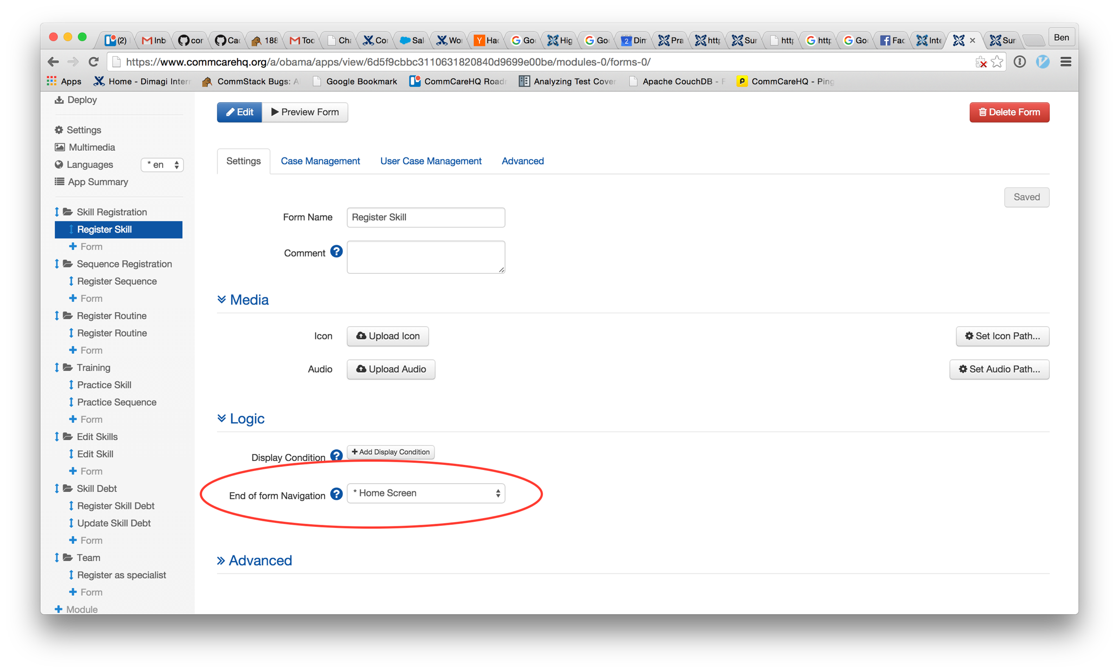
End of Form Navigation

Slide 8
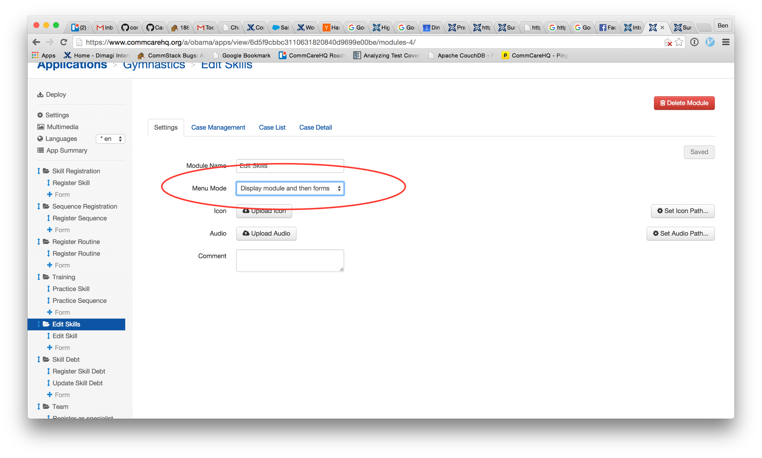
Menu Mode

Slide 9
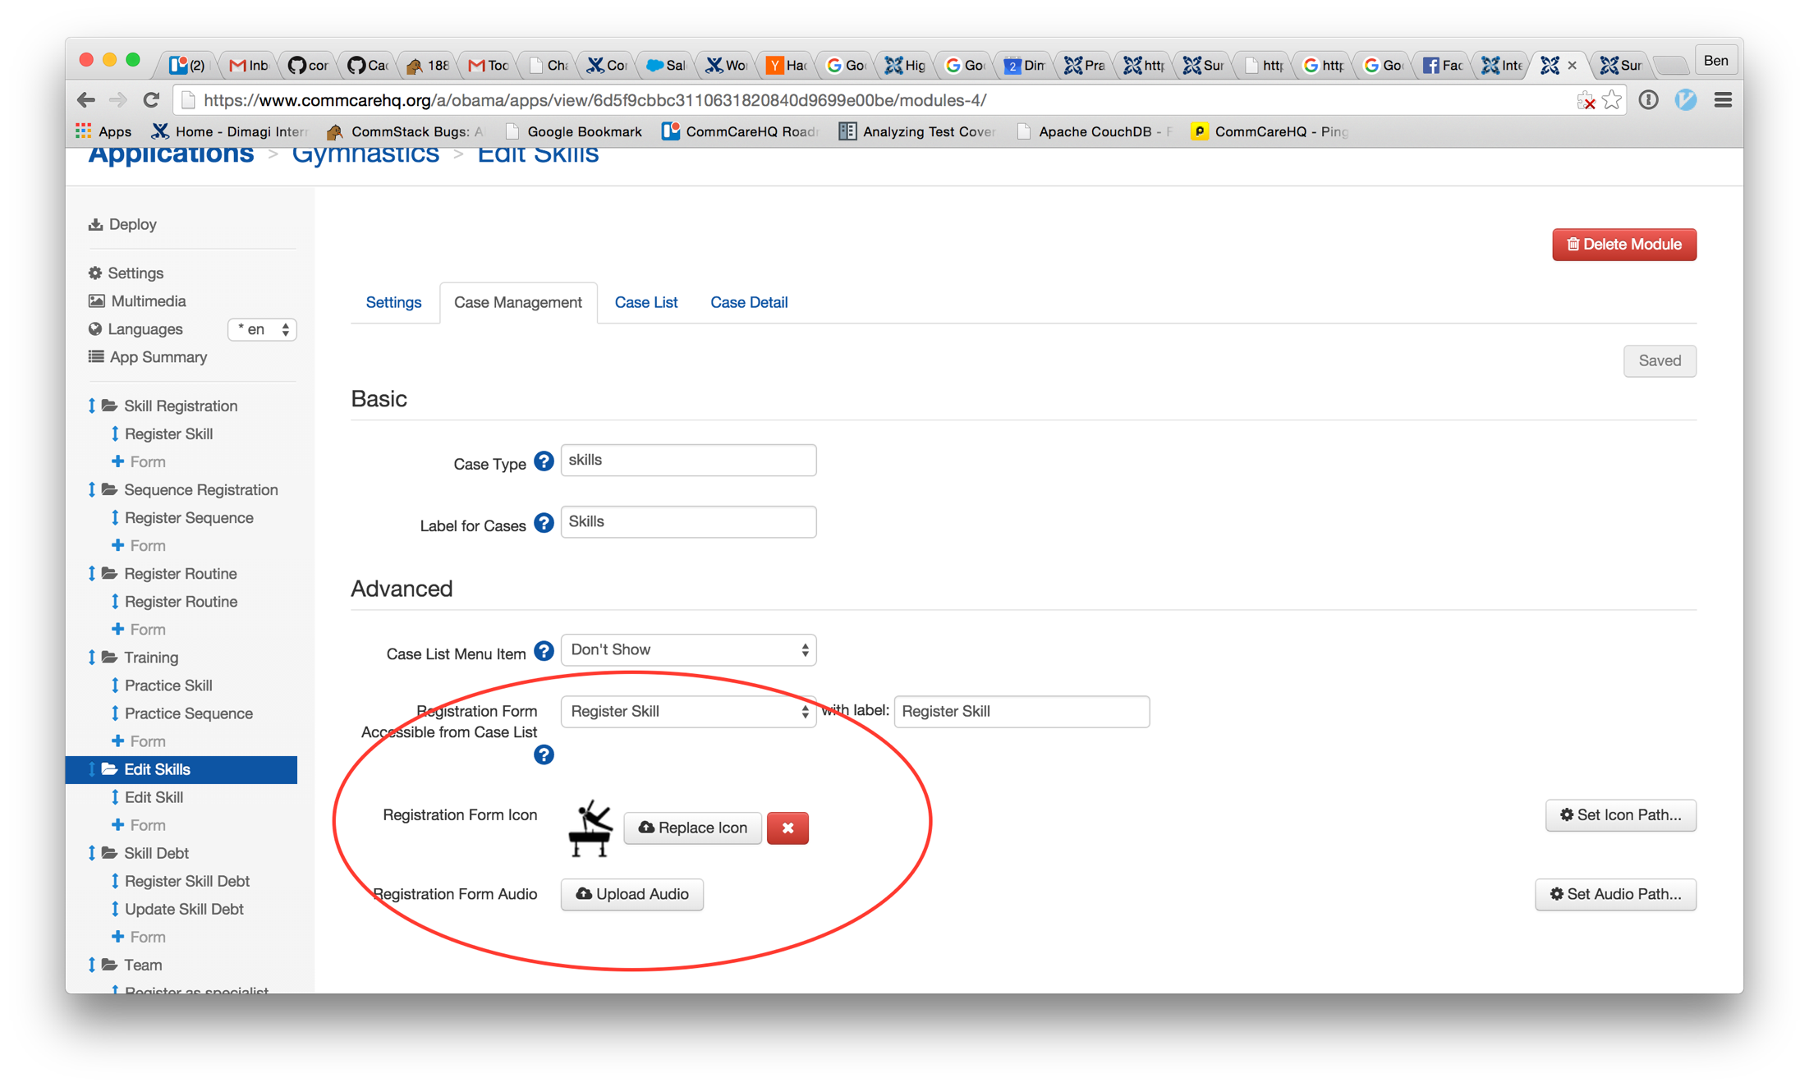
Registration Form

Slide 10
App Summary
For quick overview of what you’ve built

Slide 11
